Slide 1
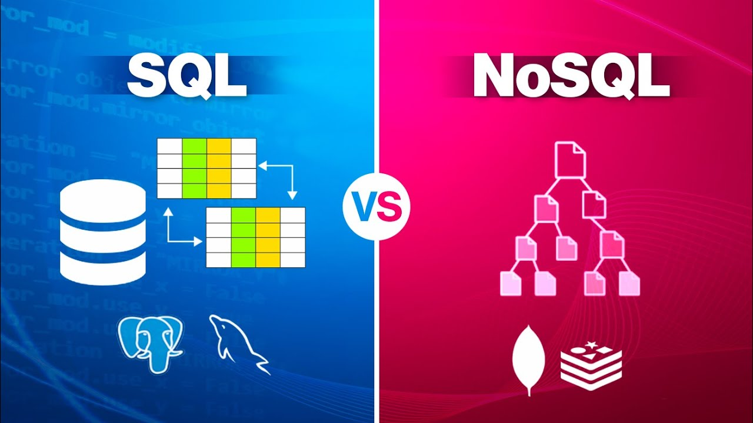
Introduction
NOSQL VS SQL
Databases play a crucial role in managing and organizing data for various applications. Two prominent approaches to database management are SQL (Structured Query Language) and NoSQL (Not only SQL). While SQL databases have been widely used for decades, NoSQL databases emerged as an alternative to address the limitations of traditional relational databases. Understanding the differences between SQL and NoSQL is essential for selecting the most suitable database solution for specific needs.

Slide 2
Difference between MongoDB and SQL
SQL (Structured Query Language) and NoSQL (Not only SQL) are two different approaches to managing and organizing data in databases. Here are the key differences between them:
MongoDB ( NoSQL):
MongoDB is a source-available cross-platform document-oriented database program. Classified as a NoSQL database program, MongoDB uses JSON-like documents with optional schemas. MongoDB is developed by MongoDB Inc. and licensed under the Server Side Public License (SSPL).
MongoDB's combination of flexibility, scalability, and powerful querying capabilities makes it a popular choice for managing unstructured or semi-structured data in a wide range of applications.

Slide 3
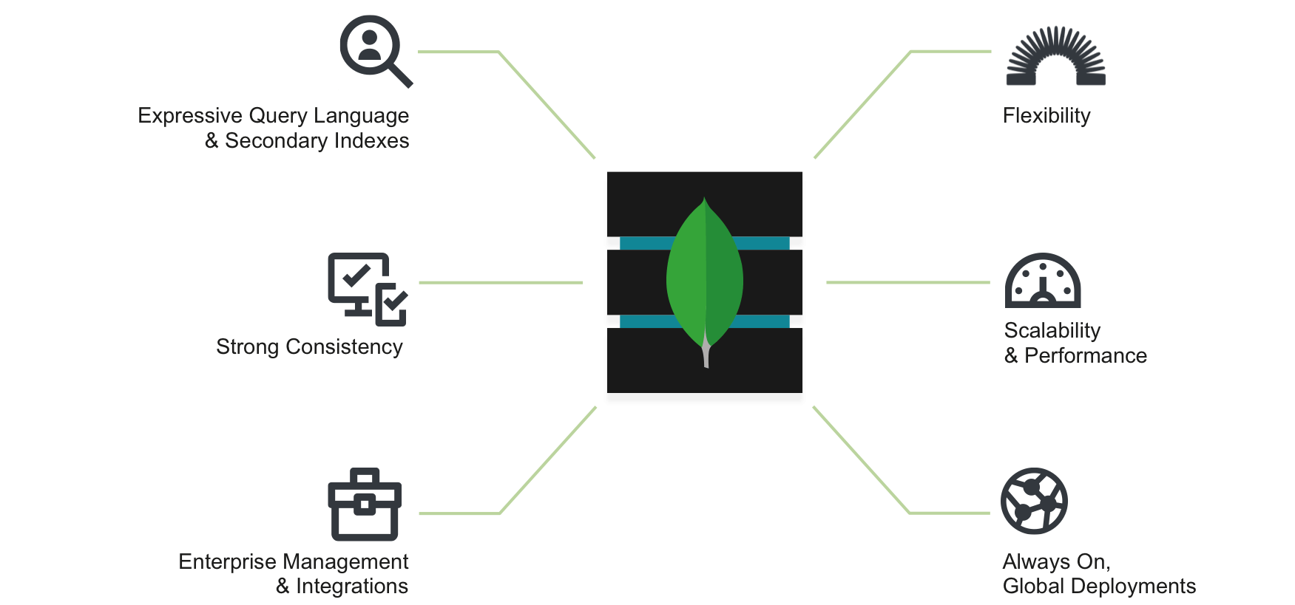

Slide 4
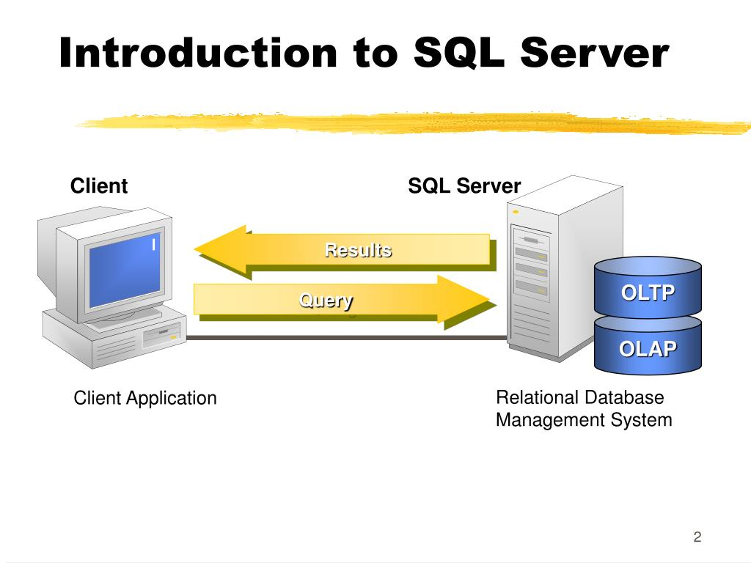
SQL:
SQL (Structured Query Language) is a programming language used for managing and manipulating relational databases .
SQL is widely used in various industries for data storage, retrieval, and management. It is essential for working with relational databases and plays a crucial role in applications that require efficient data handling, complex querying, and data analysis.
It uses commands such as "select", "insert", "update", "delete". Some common relational database management systems that use SQL are: Oracle, MySQL, Microsoft SQL Server, PostgreSQL, etc.

Slide 5
Aspect | SQL | MongoDB
Data Model | Relational | Document-oriented (NoSQL)
Schema | Predefined schema | Flexible schema
Query Language | SQL (Structured Query Language) | MongoDB Query Language (MQL)
Scalability | Vertical scaling | Horizontal scaling (sharding)
Transactions | ACID-compliant | Multi-document ACID transactions
Indexing | Supports various index types | Supports various index types
Replication | Supports replication | Supports replication (replica sets)
Data Structure | Tables with rows and columns | Documents with flexible structure
Complex Relationships | Well-suited | Less suitable
Use Cases | Structured data, complex relationships | Unstructured or semi-structured data, high scalability
Examples | MySQL, PostgreSQL, Oracle | MongoDB

